Slide 1
Course Outlines – Day 3
Objects and Classes
Object Based vs Object Oriented
Pillars of OOP
Abstraction
Encapsulation
Polymorphism
Inheritance
String Class
Object Communications
Notes:
Time: 5

Slide 2
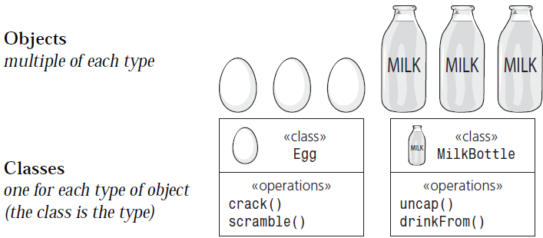
Objects and Classes
Objects and Classes
Object: Instance of a Class
Class: Blueprint of an Object
Notes:
Time: 10
- Image from Slide 12 of “1 Getting Started.pdf”

Slide 3
Objects and Classes
Class Declaration
Name Denotes Category of Objects
Instance Methods/Behaviour/Operations
Instance Members/Attributes/Fields
Class Methods/Behaviour/Operations
Class Members/Attributes/Fields
Constructors and Destructors
Access Modifiers
Scope
Object Creation and Referencing
Method Parameters
Reference “this”
Notes:
Time: 50
Method parameters: formal parameters are passed, actual parameters are in the class. Their types must be convertible
A class should do 1 thing and do it well

Slide 4
Object Based vs Object Oriented
Object Based Programming
Prototype Objects
No Inheritance
No Polymorphism
Object Oriented Programming
Entry Point Must be in a Class
No Prototype Objects
Polymorphism and Inheritance
Notes:
Time: 15
Javascript is Object-based

Slide 5
Pillars of OOP
Abstraction
Biggest Challenge in OOP
Relevant Attributes and Behaviour
Abstract and Concrete Classes
Encapsulation
Hiding Data
Hiding Implementation
Access/Mutate (simply, get/set)
Notes:
Time: 30
The greatest challenge in OOP is: choosing the right abstractions
Abstraction focuses on the visible behaviour of an object, while Encapsulation focuses on hiding the implementation that offers this behavior

Slide 6
Pillars of OOP
Polymorphism
Method Overloading
Method Overriding
Inheritance
Generalization
Specialization
Notes:
Time: 30
More in detail on Inheritance ahead

Slide 7
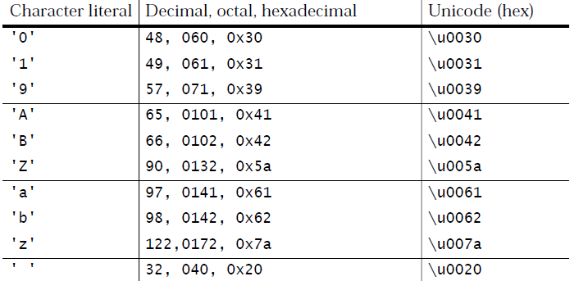
String Class
String (in Java): A finite sequence of 16-bit Unicode characters
A character literal is a Character enclosed in single quotes
A string literal is a String enclosed in double quotes
Notes:
Time: 10
A string consists of a finite sequence of characters

Slide 8
String Class
Declaration: String str creates a reference
Creation: str = new String() creates the object and provides a value to the reference
Initialization: str = “Welcome to Java…” assigns value to the instance members
Notes:
Time: 10

Slide 9
String Class
Frequently used Methods
charAt()
length()
equals() and equalsIgnoreCase()
compareTo()
concat()
indexOf() and lastIndexOf()
matches()
replace()
split()
substring()
String.valueOf()
Notes:
Estimated Time: 3h 20m

